Slide 1
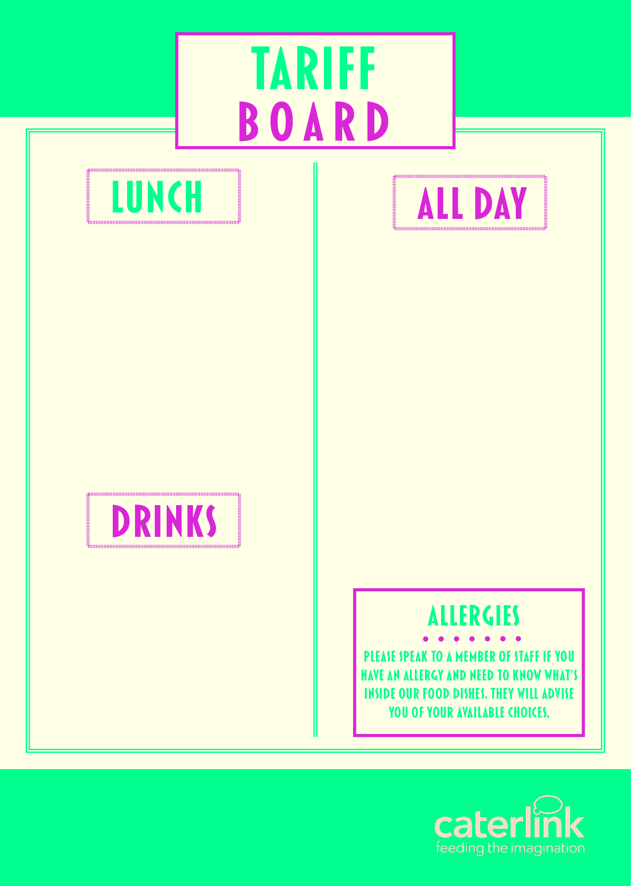
MEAL DEAL | £2.80
MAIN MEAL | £2.15
HOT DESSERT | £1..05
PIZZA SLICE | £1.90
JACKET POTATO & 1 FILLING | £2.00
PASTA & SAUCE | £2.15
PASTA, SAUCE & CHEESE | £2.40
PANINI OF THE DAY | £2.15
SALAD BOX OF THE DAY FROM | £2.10
HOMEBAKE | £1.00
COOKIE | £1.00
SANDWICHES FROM | £1.75
BAGUETTES FROM | £1.90
WRAPS FROM | £2.10
ROLLS FROM | £1.65
FRUIT POTS | £1..05
SAUSAGE ROLLS | £1.40
HOT FILLED ROLLS/SANDWICH | £2.10
CROISSANT | £1.25
PAIN AU CHOCOLAT | £1.25
WAFFLE | £1.25
BUDGET ITEM FROM | £1.25
BURGER/PATTY | £2.15
HOT WRAP/NAAN/TACO OF THE DAY | £2.15
WATER 500ML | £1.05
FLAVOURED WATER | £1.35
VIVA MILKSHAKE | £1.15
OMJ CARTONS 288ML | £1.25
RANOR FIZZ | £1.25
CAPRI SUN | £1.35
125ML JUICE | £0.65

